Slide 1
Moral Cognition
Presented by-
Rimi Deori
22DR0202
Perspectives on Human Behaviour
HSS, IIT (ISM)
14-11-22

Slide 2
Overview
Definitions
Kohlberg’s stages of moral development
Moral Foundations Theory
- Nativism
- Cultural leaning
- Intuitionism
- Pluralism

Slide 3
Definitions
Morality – distinction between right and wrong, or good and bad behaviour
Moral Cognition – is a complex process driven by moral judgments, decision-making, reasoning, emotion, rationalizations, and biases that influence an individual's moral behavior (Reese et.al., 2020).

Slide 4
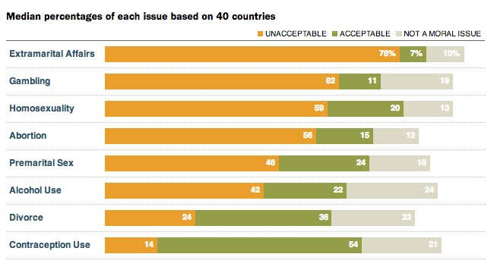

Slide 5
Lawrence Kohlberg’s stages of moral development
3 levels of moral reasoning –
Doesn’t rely on decision much, rather on the explanation of the decision.
Preconventional level : judge morality in terms of consequences (reward or punishment)
Conventional level : judge morality in terms of existing social norms and rules
Postconventional level : judge morality in terms of abstract principles and values.

Slide 6
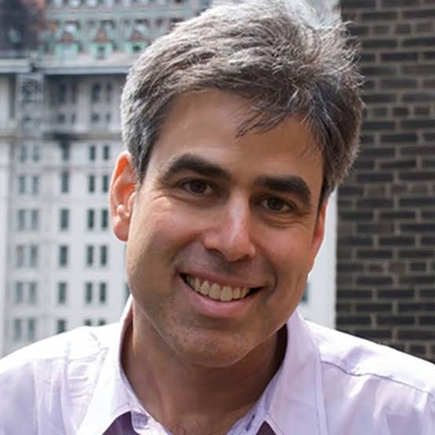
Moral Foundations Theory
Jonathan Haidt
Four claims –
Nativism
Cultural leaning
Intuitionism
Pluralism

Slide 7
Nativism : ‘first draft’ of the moral mind
Morality is Innate
Evolutionary Perspective
Natural selection theory
Morality is supposed to be a device for cooperation but also creates a sense of competition.
https://www.youtube.com/watch?v=meiU6TxysCg&list=PLcdJk1SvIv0Om235lLWWD8p4Q6ITLmG9B&index=2

Slide 8
Cultural leaning : first draft gets edited during development within culture
Morality is based on cultural learning
E.g. – Indian Hindu household, children bowing in front of elders.
Cultural difference in learning moral behaviours
E.g. – American household, no hierarchical difference

Slide 9
Intuitionism : intuition comes first, strategic reasoning second
Haidt’s Social Intuitionist Model –
Moral intuition or judgement is automatic
Moral intuition or judgement is purely based on emotions
Reasoning only serves as post-hoc justifications

Slide 10
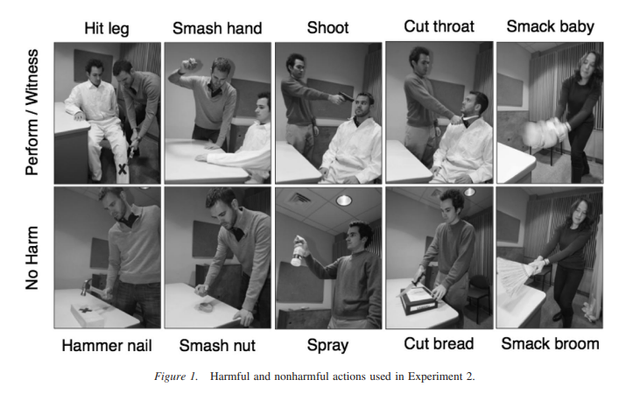
Moral intuitions – Aversion to Harmful Action, study by Cushman and colleagues (2012)

Slide 11
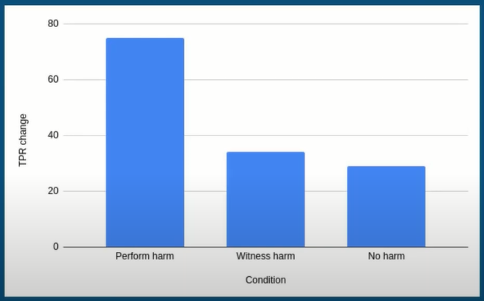
TPR = Total Peripheral Resistance = measure of vasoconstriction

Slide 12
Pluralism : the Moral Foundations Theory
The Care/harm foundation
The Fairness/cheating foundation
The Loyalty/betrayal foundation
The Authority/subversion foundation
The Sanctity/degradation foundation

Slide 13
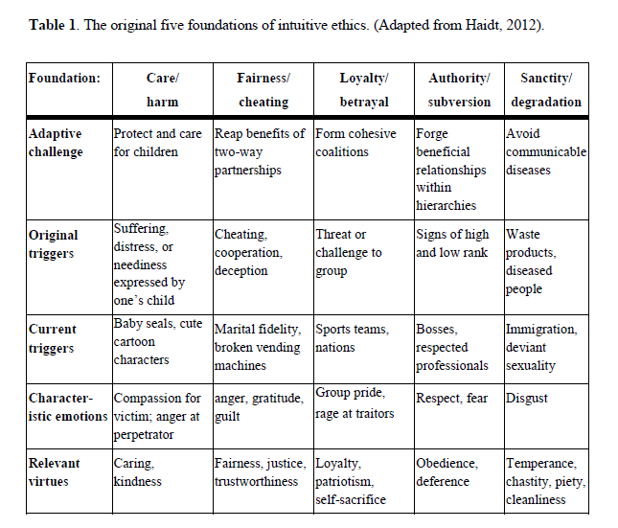

Slide 14
Conclusion
Morality is the about right from wrong.
Morality is innate in nature.
Cultural difference in morality.
Morality is intuitional.
All moral behaviours can be explained through MFT.

Slide 15
Thank You!

